Slide 2
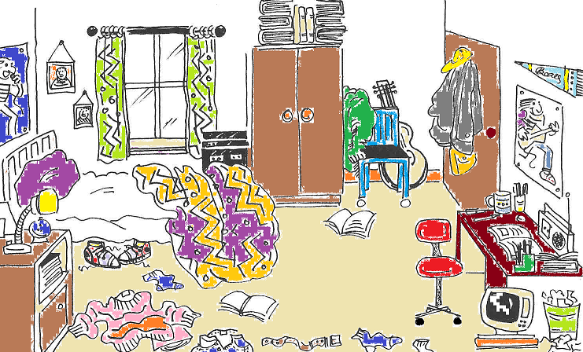
A MEMORY GAME

Slide 3
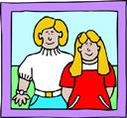
WHERE IS WHAT?
Click on the objects.

Slide 4
under
desk
on
floor
next to
bedside table
on
The is ..............
the ............................. .
bedside table
BACK
NEXT

Slide 5
under
door
in
desk
on
bed
under
The are ...................
the ................................ .
bed
BACK
NEXT

Slide 6
on
chair
next to
bed
under
computer
next to
The is ..................
the ......................... .
chair
BACK
NEXT

Slide 7
on
under
wardrobe
in
window
next to
door
on
The are ........the wall
…..............the.................. .
next to
window
BACK
NEXT

Slide 8
next to
bedside table
on
window
wardrobe
between
door
bed
between
The is …................the
...............and the…………….
window
wardrobe
BACK
NEXT

Slide 9
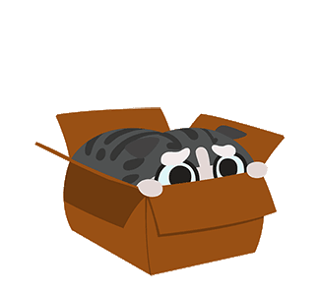
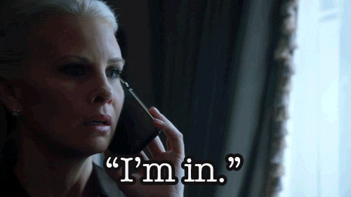
Let me in!
in
I’m in!

Slide 10
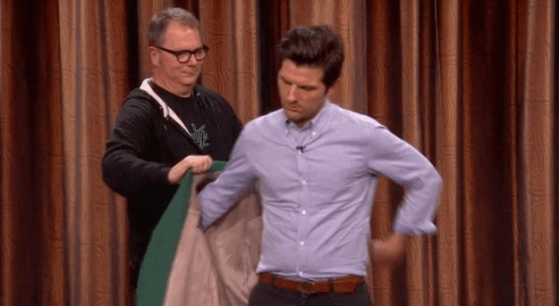
on my way
on
put on

Slide 11
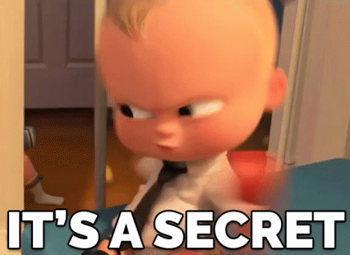
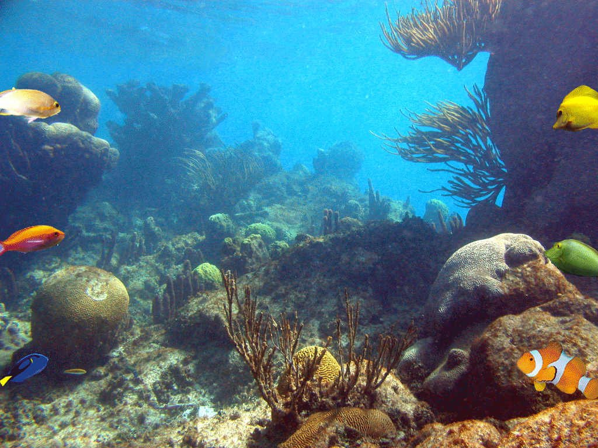
under the table
under
under the sea

Slide 12
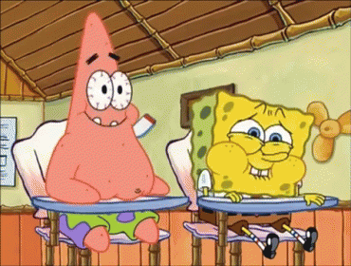
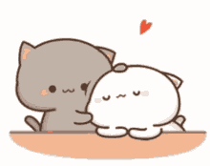
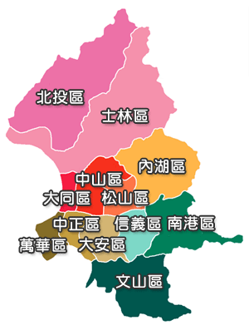
sit next to me
next to
XinYi District is next to…

Slide 13
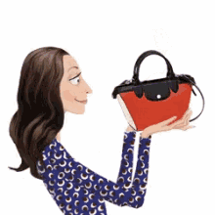
bag
a backpack
a purse

Slide 14
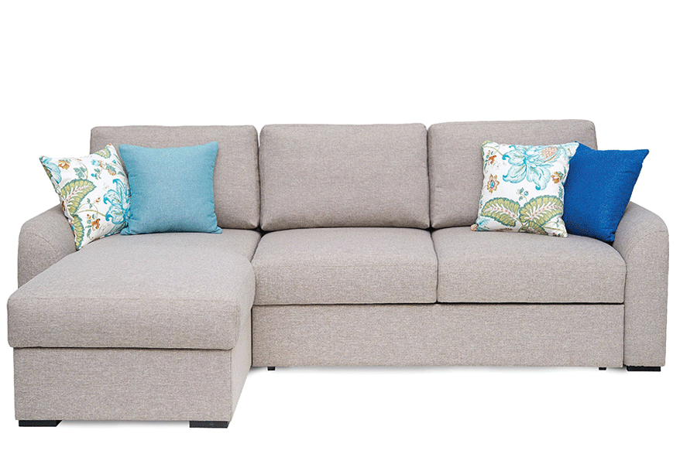
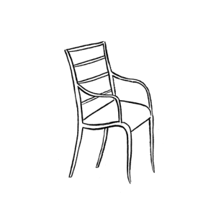
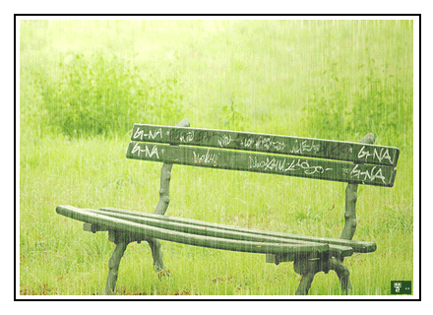
chair
a sofa
a bench

Slide 15
desk
school desk
office desk

Slide 16
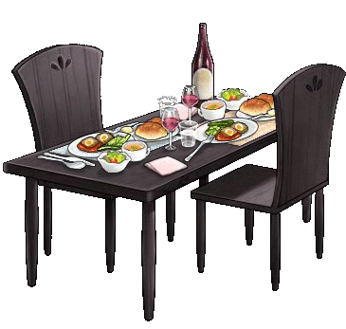
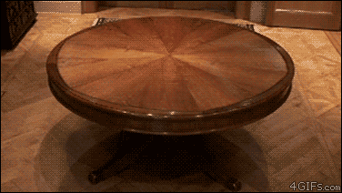
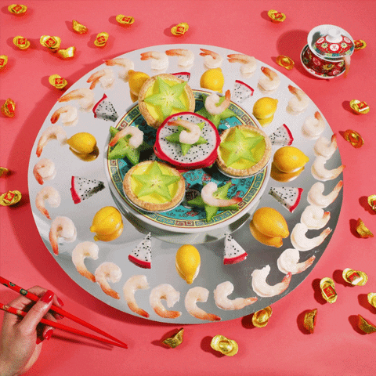
table
dining table
lazy Susan

Slide 17
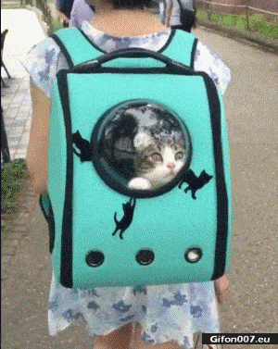
Where is the cat?
It’s ___ the bag.
in
in / on /
under/ next to

Slide 18
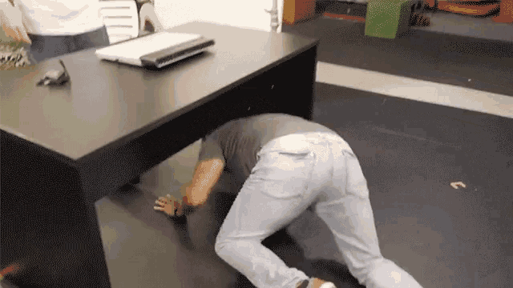
Where is the man?
He’s ____ the
desk.
under
in / on /
under/ next to

Slide 19
Where is the mushroom?
It’s ___ the chair.
on
in / on /
under/ next to

Slide 20
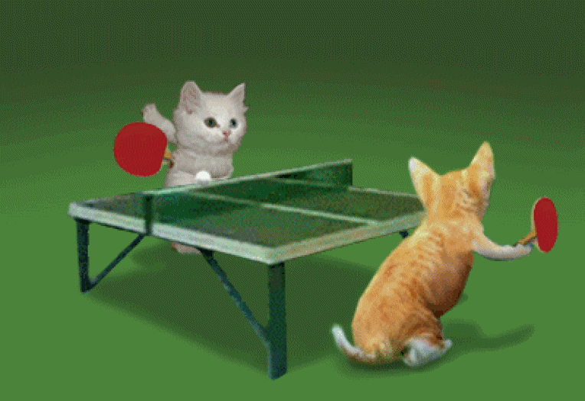
Where are the cats?
They’re ______
the table.
next to
in / on /
under/ next to

Slide 21
Where is Pikachu?
It’s __ the box.
in
in / on /
under/ next to

Slide 22
Where is the man?
He’s __ the ball.
on
in / on /
under/ next to

Slide 23
Where are the eggs?
under
They’re ____ the penguins.
in / on /
under/ next to

Slide 24
Where is Belle?
She’s ______ the bad guy.
next to
in / on /
under/ next to

Slide 25
The pony is ______ the desk.
in
on
under
next to

Slide 26
The cat is ______ the rabbit.
in
on
under
next to

Slide 27
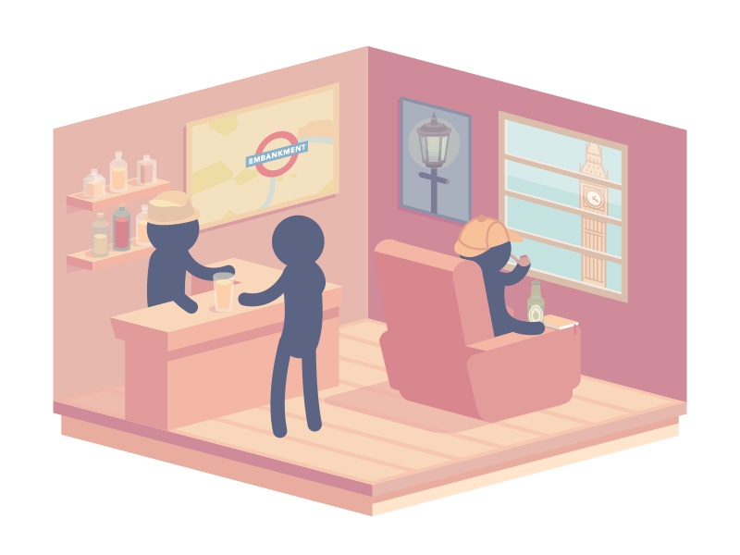
They are ______ the store.
in
on
under
next to

Slide 28
The cow is ______ the car.
in
on
under
next to

Slide 29
The worms are ______ the stone.
in
on
under
next to

Slide 30
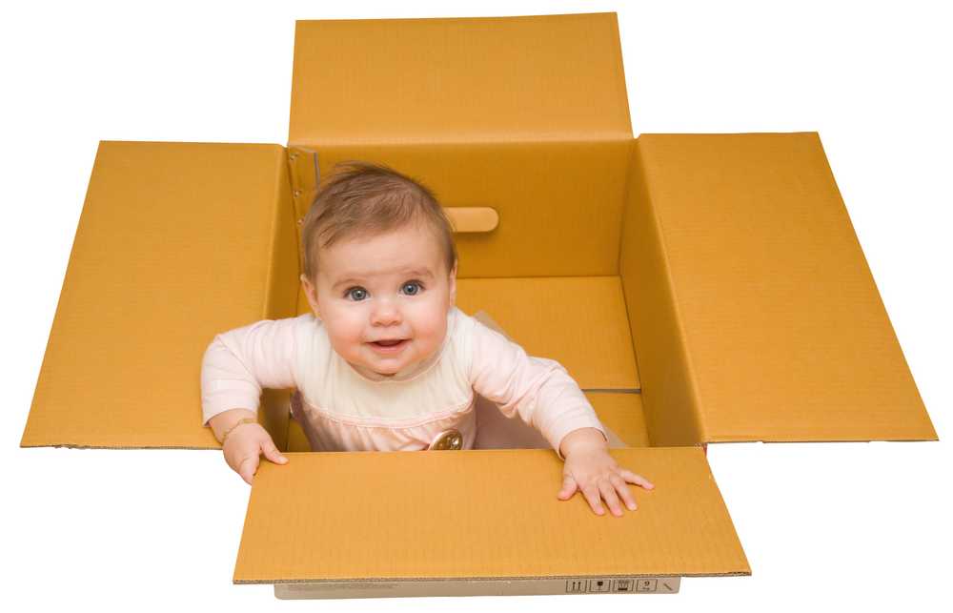
The baby is ______ the box.
in
on
under
next to

Slide 31
The spider is _____ the roof.
in
on
under
next to

Slide 32
The pigs are ______ the tiger.
in
on
under
next to

Slide 33
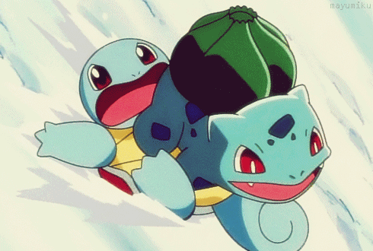
Squirtle is ______ Bulbasaur.
in
on
under
next to

Slide 34
Newton is ______ the apple tree.
in
on
under
next to

Slide 35
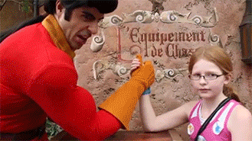
Harder Challenge!!!!!

Slide 36
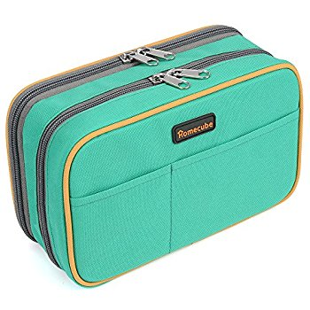
Prepare these things……

Slide 37
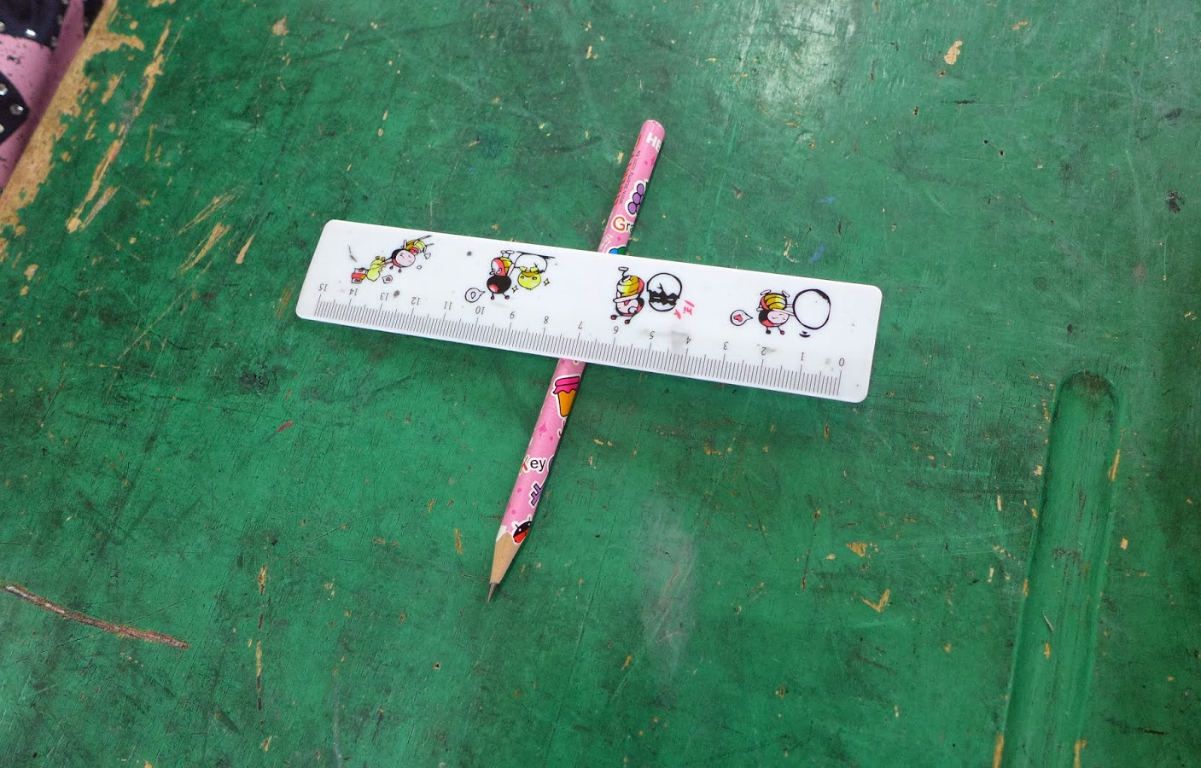
1. Clear your desk. 2. Put all things into the drawer. 3. After the instructions, you can put the things on the desk.

Slide 38
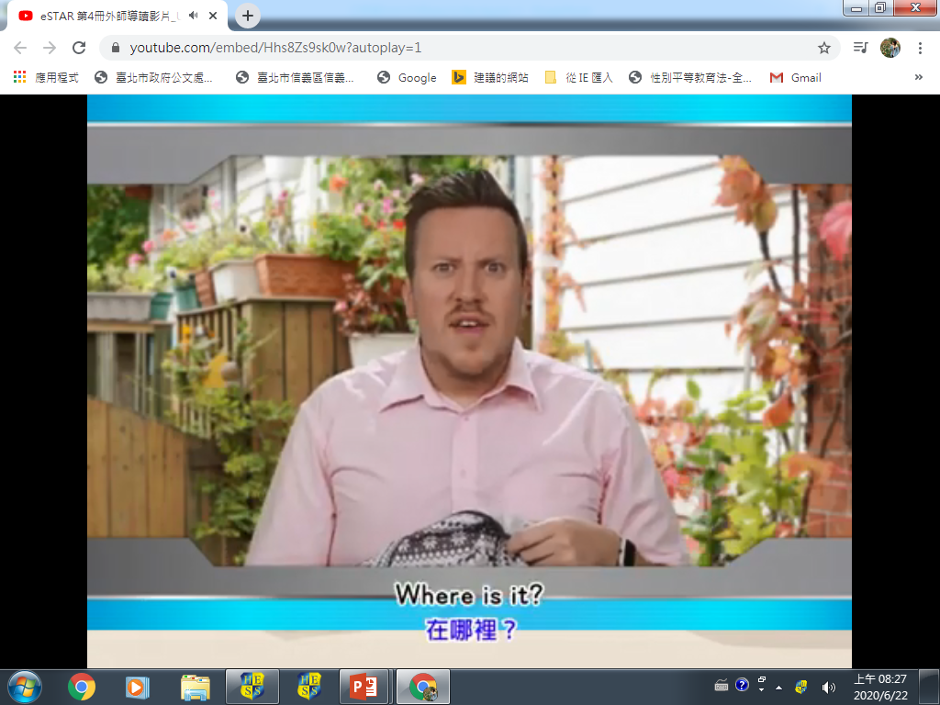

Slide 39
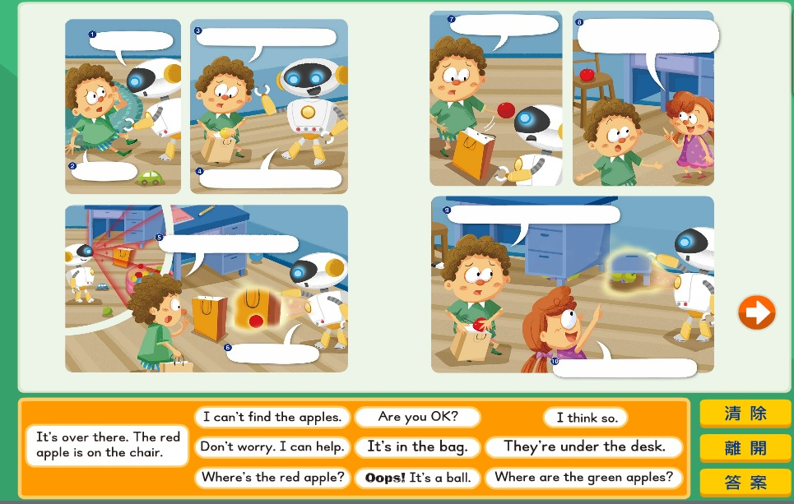
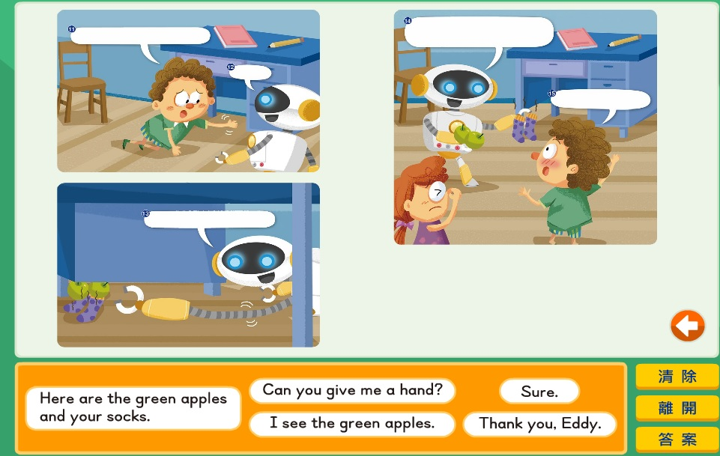

Slide 40
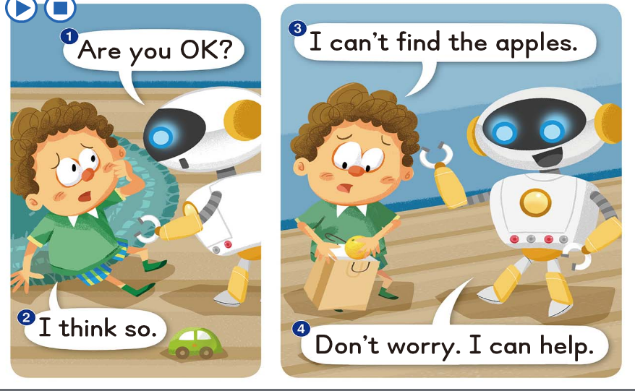

Slide 41
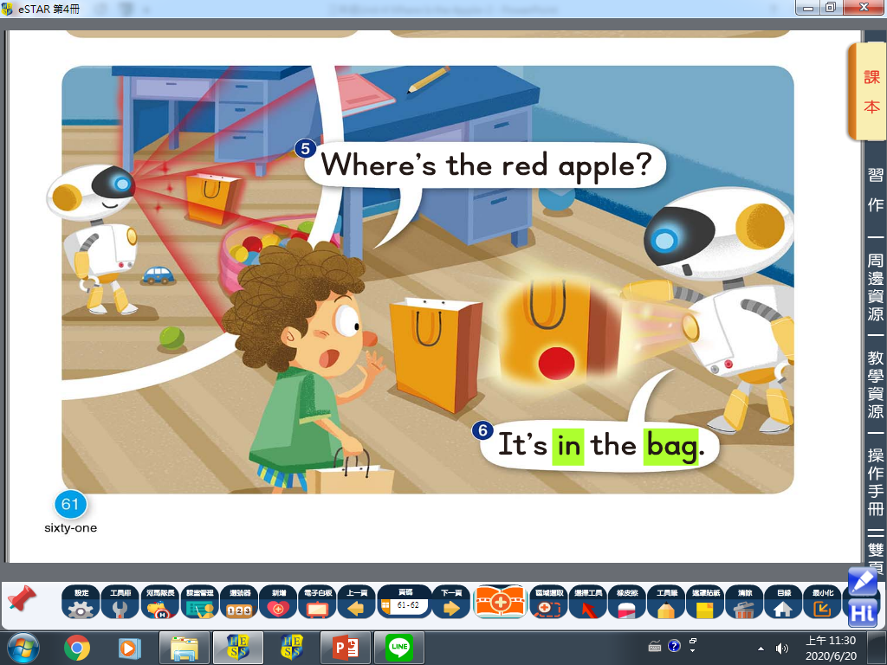

Slide 42
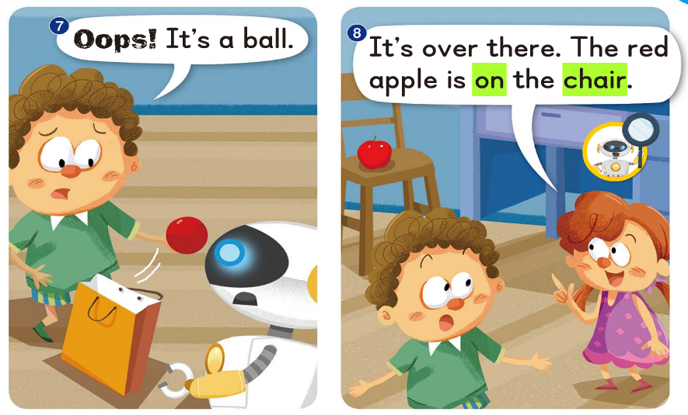

Slide 43
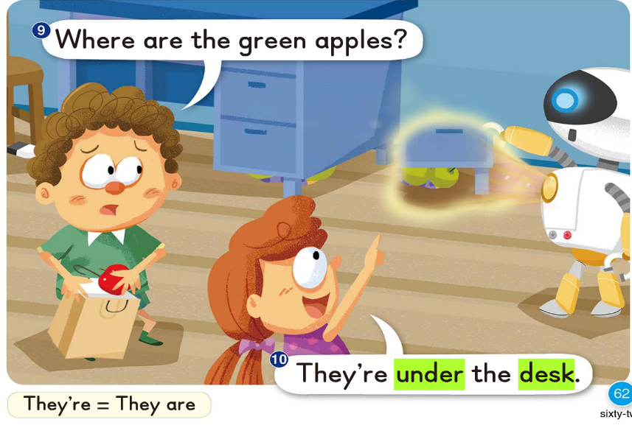

Slide 44
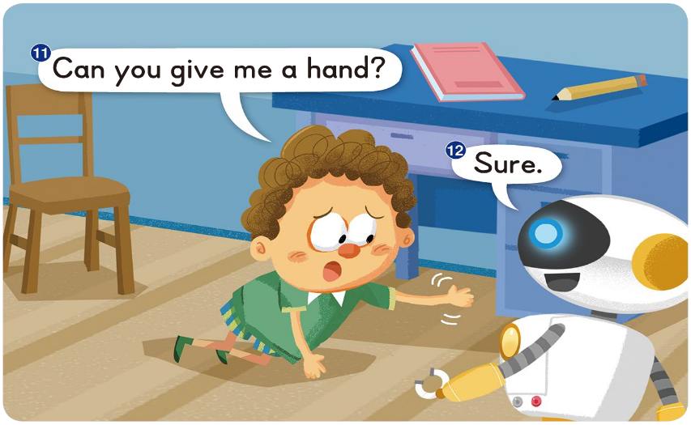

Slide 45
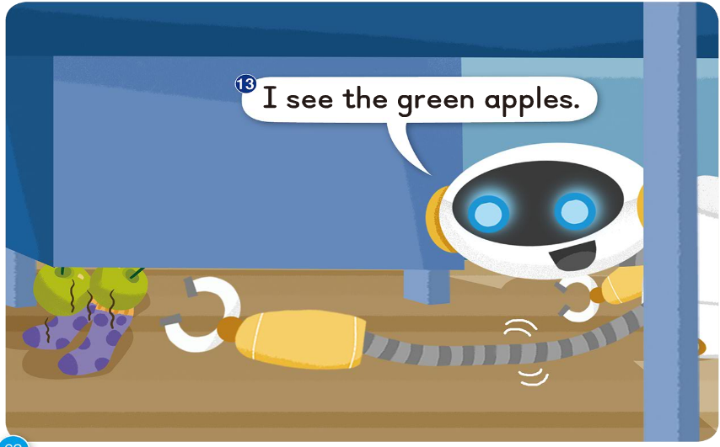

Slide 46
